Slide 1
Introduction to Programming Paradigms and Core Language Design Issues Module I
Mrs Pooja Shetty

Slide 2

Why do we need programming language?

Slide 3

Why so many programming language?
Do I need to learn them all?

Slide 4
Evolution - finding better ways to do things
Special Purposes
Programmer friendly
Ease of Implementation
Support
Good Compilers/ Interpreters
Why study?
Choose among alternative ways to express things
Make good use of debuggers, assemblers, linkers, and related tools

Slide 5
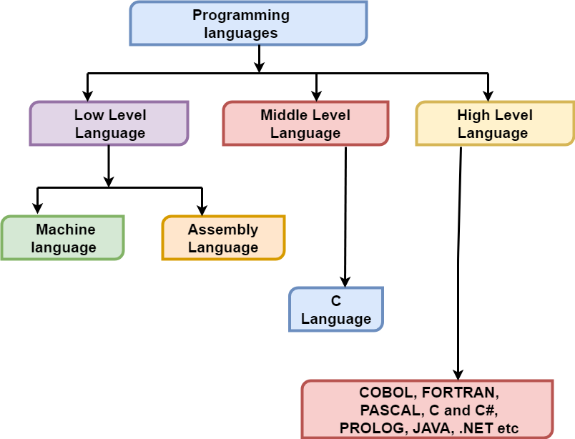
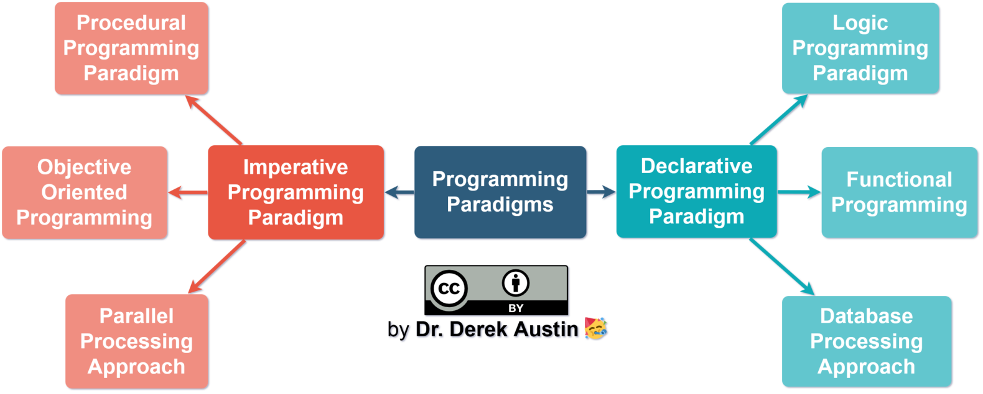
Categories of languages
1)
2)
Source :https://www.tutorialandexample.com/low-level-language/
:https://medium.com/javascript-in-plain-english/what-are-javascript-programming-paradigms-3ef0f576dfdb
Notes:
Source :https://www.tutorialandexample.com/low-level-language/
:https://medium.com/javascript-in-plain-english/what-are-javascript-programming-paradigms-3ef0f576dfdb

Slide 6
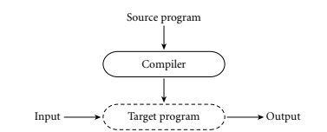
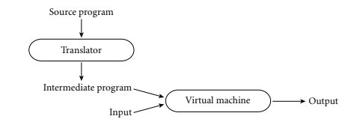
3)
Compiled and Interpreted Languages

Slide 7
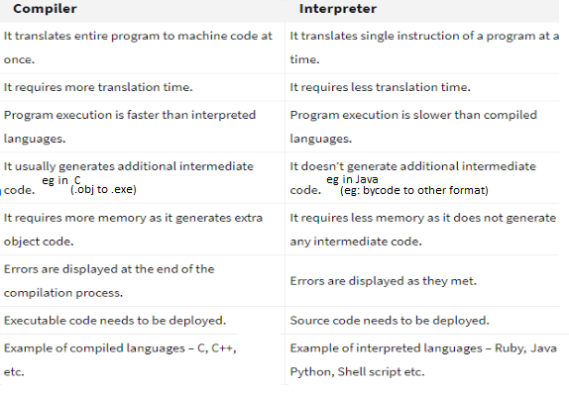
https://codeforwin.org/2017/05/compiler-and-its-need.html
https://codeforwin.org/2017/05/interpreter-and-its-need.html

Slide 8
What is programming paradignm?
A programming paradigm is a style, or “way,” of programming.
It’s a concept not a language
Not a syntax
It’s about writing / organizing your code.
Source: https://cs.lmu.edu/~ray/notes/paradigms/

Slide 9
Some of the Common Paradigms
Imperative ( How)
Declarative (What)
Procedural (make call to modules)
Functional ( function call, no global var)
Object-Oriented (Objects and Classes)
Event-Driven (listens to actions)
Logic (Rule-based)
Notes:
https://codeforwin.org/2017/05/various-programming-paradigms.html
https://www.geeksforgeeks.org/introduction-of-programming-paradigms/#:~:text=Database%2FData%20driven%20programming%20approach%20%E2%80%93&text=There%20are%20several%20programming%20languages,)%2C%20or%20calling%20other%20programs.

Slide 10
Imperative
Changes the program state through assignment statements.
Performs step by step task by changing state.
How to achieve the goal.
approach to solve problem using some programming language
after execution of all the result is store

Slide 11
Declarative
expresses logic of computation without talking about its control flow.
what needs to be done rather how it should be done

Slide 12
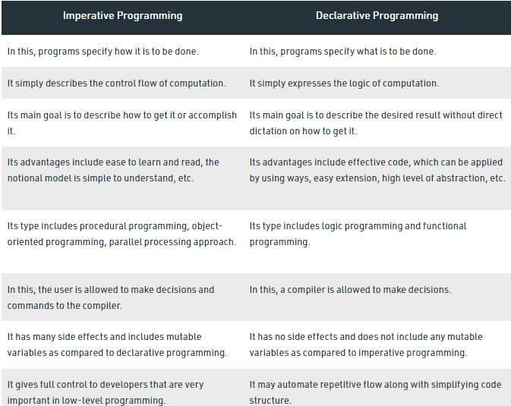

Slide 13
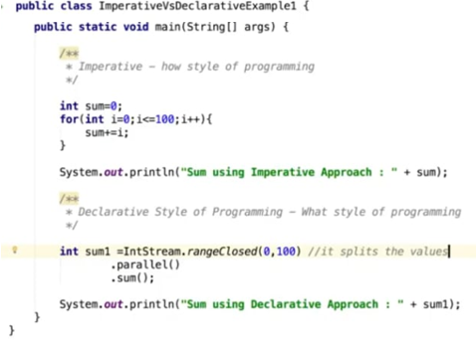
Difference between paradigms
Imperative / Declarative
HOW WHAT

Slide 14
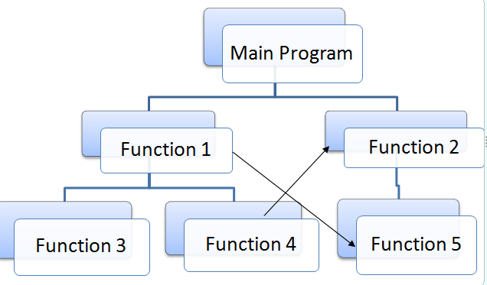
Procedural
Global Data
Global Data
Global Data
Global Data

Slide 15
programming paradigm built around the idea that programs are sequences of instructions to be executed
Program code is divided up into procedures, discrete blocks of code that carry out a single task.
Procedures, also known as routines, subroutines, or functions, simply contain a series of computational steps to be carried out in the order specified by the programmer

Slide 16
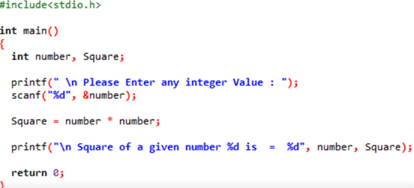
Procedural
C

Slide 17
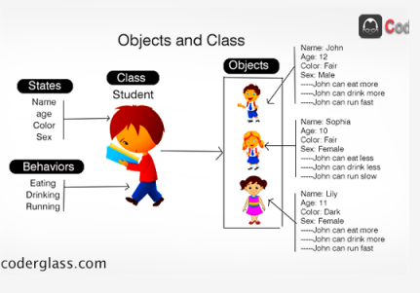
Object Oriented

Slide 18
Emphasis is on data rather procedure.
Object Oriented programming (OOP) is a programming paradigm that relies on the concept of classes and objects.

Slide 19
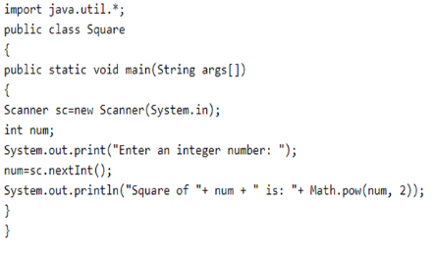
Object Oriented
Java

Slide 20
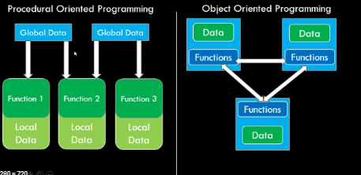
https://www.youtube.com/watch?v=Jt13s8RYAVg

Slide 21
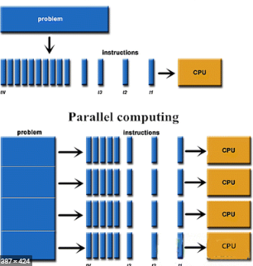
Parallel Processing
program instructions by dividing them among multiple processors
Shared memory
Message passing

Slide 22
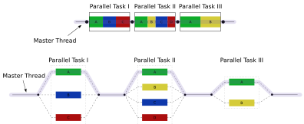
Java, C#, Go
https://en.wikipedia.org/wiki/Fork%E2%80%93join_model

Slide 23
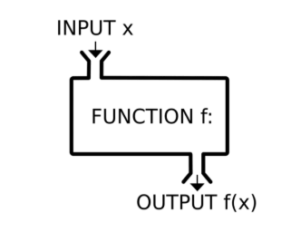
Functional
mathematical equation
immutable data

Slide 24
Functional programming is a programming paradigm in which we try to bind everything in pure mathematical functions style.
It uses expressions instead of statements.
An expression is evaluated to produce a value whereas a statement is executed to assign variables
Functional Programming is based on Lambda Calculus

Slide 25
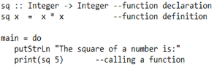
Haskell
Notes:
Python, kotlin

Slide 26
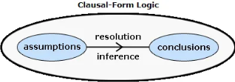
Logic
Logic programming is a computer programming paradigm where program statements express facts and rules about problems within a system of formal logic
formulas in mathematical logic
we describe the relationship between the input data and the output data
the computer figure out how to obtain the output from the input

Slide 27
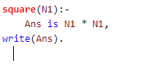
Prolog

Slide 28
Data driven
model primitive functional nodes.
They provide an inherently parallel model:
nodes are triggered by the arrival of input tokens

Slide 29
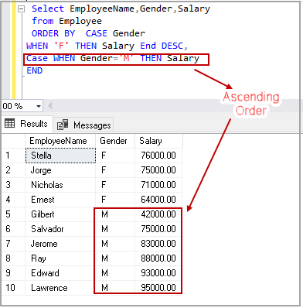
SQL

Slide 30
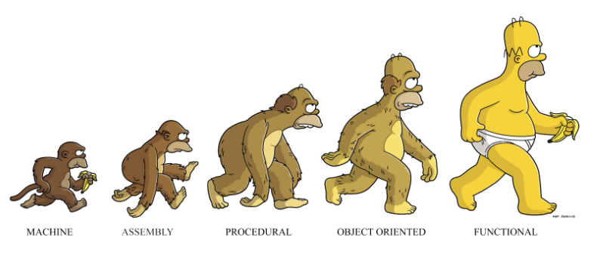
Smalltalk –Object oriented
Haskel –Fucntional
Python - procedural, object oriented, imperative, functional
C++, PHP – Object oriented / Procedural
CSS - Declarative

Slide 31
Core Language Design Issues

Slide 32
High level programming languages introduced high level of abstraction
By abstracting the language away from the hardware, designers not only made it possible to write programs that would run well on a wide variety of machines, but also made the programs easier for human beings to understand
By hiding irrelevant details, abstraction reduces conceptual complexity, making it possible for the programmer to focus on a manageable subset of the program text at any particular time

Slide 33
Name
A name is a mnemonic character string used to represent something else.
Names in most languages are identifiers
Identifiers like variables, constants, types and so on using symbolic identifiers rather than low-level concepts like addresses
Names introduce data abstraction and control abstraction
These names need to be binded to actual memory locations (addresses)

Slide 34
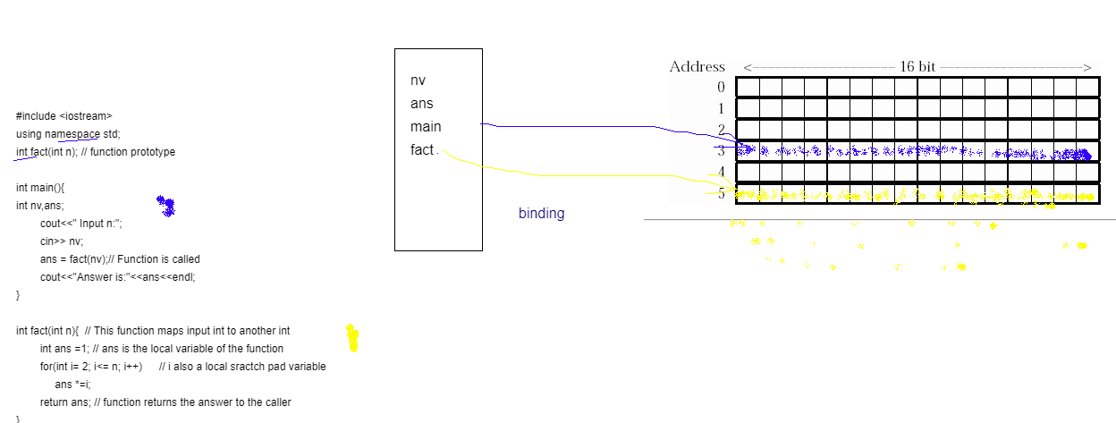

Slide 35
Binding

Slide 36
Binding
A binding is an association between two things
Name of a variable and its address
Name of the operator and its meaning
Binding time is the time at which a binding is created or, more generally,the time at which any implementation decision is made
Which name to which address?

Slide 37
Broadest way of classifying Binding time is
Runtime /Late binding
Compile time / Early binding

Slide 38
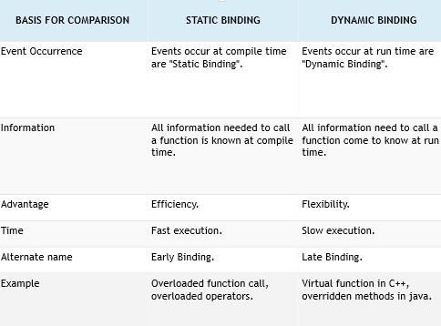

Slide 39
Different times at which decisions may be bound:
Language design time: Aspects of language semantics are chosen when the language is designed.
control flow constructs
primitive types constructors for creating complex types eg: keywords)
Language implementation time: Most language manuals leave a variety of issues to the discretion of the language implementor.
precision (number of bits) of the fundamental types
I/O to the operating system’s notion of files
the organization and maximum sizes of stack and heap, and the handling of run-time
exceptions such as arithmetic overflow.
max identifier name length

Slide 40
Program writing time: Programmers, of course, choose algorithms, data structures and names.
Compile time: Compilers choose the mapping of high-level constructs to machine code, including the layout of statically defined data in memory.
Link time: Since most compilers support separate compilation compiling different modules of a program at different times and depend on the availability of a library of standard subroutines
a program is usually not complete until the various modules are joined together by a linker.
Virtual memory mapping
When a name in one module refers to an object in another module, the binding between the two is not finalized until link time.
External symbols are linked to a specific set of object files and libraries

Slide 41
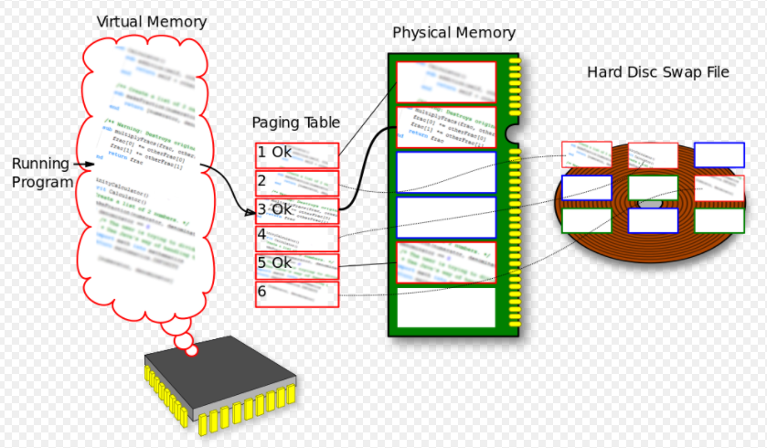
https://en.wikipedia.org/wiki/Memory_address#/media/File:Paging.svg

Slide 42
Load time: Load time refers to the point at which the operating system loads the program into memory so that it can run. In primitive operating systems,
Most modern operating systems distinguish between virtual and physical addresses. Virtual addresses are chosen at link time;
Physical addresses can actually change at run time.
The processor’s memory management hardware translates virtual addresses into physical addresses during each individual instruction at run time.
Run time: Run time is actually a very broad term that covers the entire span from the beginning to the end of execution
Bindings of values to variables occur at run time,

Slide 43
Scope and Scope Rules

Slide 44
Scope
The textual region of the program in which a binding is active is its scope
The complete set of bindings in effect at a given point in a program is known as the current referencing environment

Slide 45
Lifetime and Storage Management
Bindings key events:
creation of objects
creation of bindings
references to variables (which use bindings)
(temporary) deactivation of bindings
reactivation of bindings
destruction of bindings
destruction of objects

Slide 46
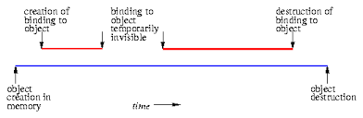
The period of time between the creation and the destruction of a name-to- object binding is called the binding’s lifetime.
The time between the creation and destruction of an object is the object’s lifetime.

Slide 47
If object outlives binding it's garbage
If binding outlives object it's a dangling reference, e.g., if an object created via the C++ new operator is passed as a & parameter and then deallocated (delete-ed) before the subroutine returns

Slide 48
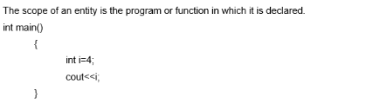
Scope Rules
Three rules

Slide 49
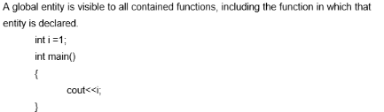

Slide 50
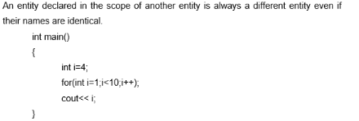

Slide 51
Storage Management

Slide 52
Storage Allocation mechanisms are used to manage the object’s space:
Static: the objects are given an absolute address that is retained throughout the program’s execution
Stack: the objects are allocated and deallocated in last-in, first-out order, usually in conjunction with subroutine calls and returns.
Heap: the objects may be allocated and deallocated at arbitrary times (require a complex storage management mechanism).

Slide 53
Static allocation for:
code (and small constants often stored within the instruction itself)
globals
static or own variables
explicit constants (including strings, sets, etc.), e.g., printf ("hello,
world n")
Arguments and return values
Temporaries (intermediate values produced in complex claculations)
Bookkeeping information (subroutine’s return address, a reference to
the stack frame of the caller (the dynamic link ), additional saved
registers, debugging information

Slide 54
Stack
Why a stack
allocate space for recursive routines
reuse space
Each instance of a subroutine at run time has its own frame (or activation record ) for
parameters
local variables
temporaries (return address)
Maintenance of the stack is the responsibility of the subroutine calling sequence (the code executed by the caller immediately before and after the call),which includes: the prologue (code executed at the beginning) and epilogue (code executed at the end) of the subroutine itself.

Slide 55
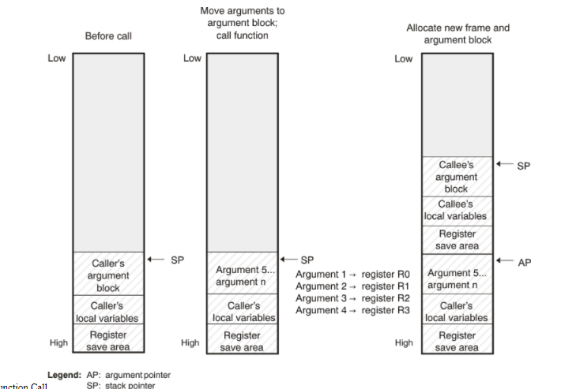
http://downloads.ti.com/docs/esd/SPNU151T/function-structure-and-calling-conventions-stdz0545494.html

Slide 56
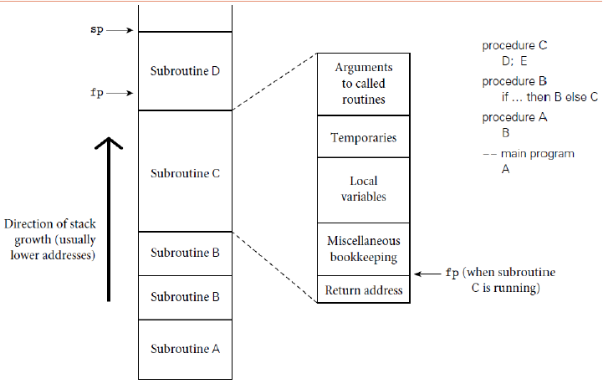

Slide 57
Heap Based Allocation
Heap is for dynamic allocation
A heap is a region of storage in which sub blocks can be allocated and deallocated at arbitrary times
dynamically allocated pieces of data structures:
objects, Strings, lists, and sets, whose size may change as a result of an assignment statement or other update operation

Slide 58
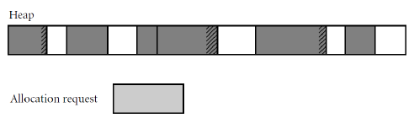
Fragmentation :
Internal fragmentation occurs when a storage management algorithm allocates a block that is larger than required to hold a given object.
External fragmentation occurs when the blocks that have been assigned to active objects are scattered through the heap in such a way that the remaining, unused space is composed of multiple blocks: there may be quite a lot of free space, but no one piece of it may be large enough to satisfy some request
compaction, paging or segmentation

Slide 59
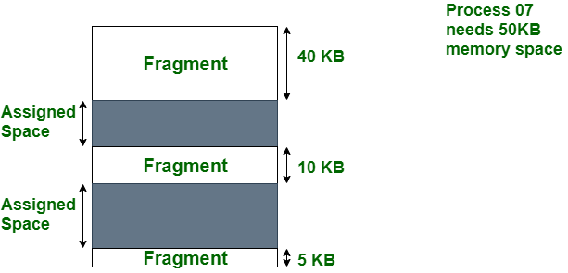
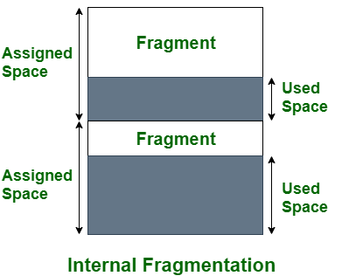

Slide 60
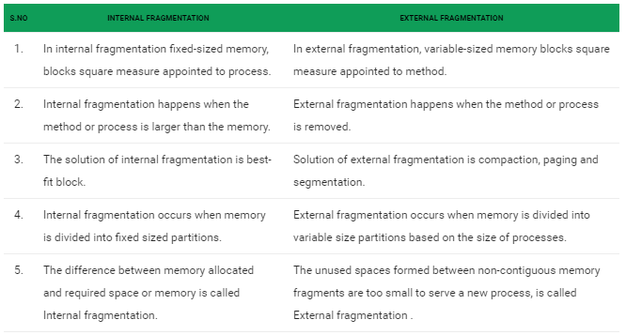

Slide 61
The storage management algorithm maintains a single linked
list, the free list , of heap blocks not currently in use
The first fit algorithm selects the first block on the list that is
large enough to satisfy a request
The best fit algorithm searches the entire list to find the smallest block that is large enough to satisfy the request
Common mechanisms for dynamic pool adjustment:
The buddy system : the standard block sizes are powers of two
The Fibonacci heap: the standard block sizes are the Fibonacci
numbers
Compacting the heap moves already allocated blocks to free large
blocks of space

Slide 62
Garbage Collection
In languages that deallocation of objects is not explicit
Manual deallocation errors are among the most common and costly bugs in real world programs
Objects are to be deallocated implicitly when it is no longer possible to reach them from any program variable
Costly

Slide 63
Static Scoping

Slide 64
Type Systems

Slide 65
Type Systems
bits in memory can be interpreted in different ways
– instructions
– addresses
– characters
– integers, floats, etc.
bits themselves are untyped, but high-level languages associate types with values
– to provide the contextual information
– allows error checking

Slide 66
Type Systems, Type Checking, Equality Testing and Assignment.

Slide 67
Definition: A type system is a set of types and type constructors (arrays, classes, etc., built from existing primitive type) along with the rules that govern whether or not a program is legal with respect to types (i.e., type checking).
Definition: A type constructor is a mechanism for creating a new type
Eg: ARRAY is a type constructor since when we apply it to an index type and an element type it creates a new type: an array type. class in C++ is another example of a type constructor.
As an extreme example, one can do this in C++ but not in Java: int x = (int) “Hello”;

Slide 68
Why do different languages use different type systems?
no one perfect type system.
Each type system has its strengths and weaknesses. Thus, different languages use different type systems because they have different priorities.
A language designed for writing operating systems is not appropriate for programming the web; thus they will use different type systems. When designing a type system for a language, the language designer needs to balance the tradeoffs between execution efficiency, expressiveness, safety, simplicity, etc.
Thus, a good understanding of type systems is crucial for understanding how to best exploit programming languages.

Slide 69
a type system consists of
– a way to define types and associate them with language constructs
constructs that must have values include constants, variables, record fields, parameters, literal constants, subroutines, and complex expressions containing these
– rules for type equivalence, type compatibility, and type inference
type equivalence: when the types of two values are the same
type compatibility: when a value of a given type can be used in a particular context
type inference: type of an expression based on the types of its part,
Notes:
what is the type of an expression, given the types of the operands?).Eg: polymorphic variables

Slide 70
Type Checking
type checking ensures a program obeys the language’s type compatibility rules
– type clash: violation of type rules
Strongly/ Weakly
a language is strongly typed if it prohibits an operation from performing on an object it does not support
– A strongly-typed language is one in which variables are bound to specific data types, and will result in type errors if types do not match up as expected in the expression
– eg : Java, Python
Weakly-typed languages make conversions between unrelated types implicitly

Slide 71
Statically/ Dynamically
a language is statically typed if it is strongly typed and type checking can be performed at compile time
– eg :Java, C, C++, Haskell, FORTRAN, Pascal and Scala
a language is dynamically typed if type checking is performed at run time
– late binding
– List and Smalltalk
– scripting languages, such as Python and Ruby

Slide 72
Polymorphism
polymorphism results when the compiler finds that it doesn't need to know certain things
– allows a single body of code to work with objects of multiple types
– with dynamic typing, arbitrary operations can be applied to arbitrary objects
implicit parametric polymorphism: types can be thought of to be implied unspecified parameters
incurs significant run-time costs
Eg: ML’s type inference/unification scheme

Slide 73
subtype polymorphism in object-oriented languages
– a variable of the base type can refer to an object of the derived type
– explicit parametric polymorphism, or generics
C++, Eiffel, Java
useful for container classes List where T is left unspecified

Slide 74
Data Types
we all have developed an intuitive notion of what types are that they are of 3 kinds
– collection of values from a domain (the denotational approach)
approach for providing mathematical meaning to systems and programming languages by constructing mathematical objects (called denotations) that describe the meanings of expressions from the languages.

Slide 75
– internal structure of data, described down to the level of a small set of fundamental types (the structural approach)
type is either one of a small collection of built-in types (integer, character, Boolean, real, etc.; also called primitive or predefined types),
or
a composite type created by applying a type constructor (record, array, set, etc.)to one or more simpler types

Slide 76
– collection of well-defined operations that can be applied to objects of that type (the abstraction approach)

Slide 77
Classification of Types
most languages provide a set of built-in types
– integer
– boolean
• often single character with 1 as true and 0 as false
• C: no explicit boolean; 0 is false, anything else is true
– char
• traditionally one byte
• ASCII, Unicode
– real

Slide 78
numeric types
– C and Fortran distinguish between different lengths of integers
– C, C++, C#, Modula-2: signed and unsigned integers
– differences in real precision cause unwanted behavior across
machine platforms
– some languages provide complex, rational, or decimal types

Slide 79
enumeration types
– An enumeration type consists of a set of named elements
– facilitate readability
– allow compiler to catch errors
– An enumeration type consists of a set of named elements
Pascal
type weekday = (sun, mon, tue, wed, thu, fri, sat);
for today := mon to fri do begin …

Slide 80
The ordered nature of enumerations facilitates the writing of enumeration-controlled loops
for today := mon to fri do begin …
It also allows enumerations to be used to index arrays:
var daily_attendance : array [weekday] of integer;
C
enum weekday {sun, mon, tue, wed, thu, fri, sat};
or
typedef int weekday;
const weekday sun = 0, mon = 1, tue = 2,
wed = 3, thu = 4, fri = 5, sat = 6;

Slide 81
subrange types
– contiguous subset of discrete base type
– helps to document code
– most store the actual values rather than ordinal locations
Pascal
type test_score = 0..100;
workday = mon..fri;
Ada
type test_score is new integer range 0..100;
subtype workday is weekday range mon..fri;
• needs two bytes

Slide 82
composite types
– records (structures)
Cobol
fields of possibly different type
similar to tuples
– variant records (unions)
multiple field types, but only one valid at a given time
– arrays
as a function that maps members of an index type to members of a component type.
– sets
Discrete
like enumerations and subranges

Slide 83
– pointers
reference to an object of the pointer’s base type.
good for recursive data types
– lists
head element and following elements
variable length, no indexing
– files
mass storage, outside program memory
linked to physical devices (e.g., sequential access)

Slide 84
Orthogonality
– operations change just one thing without affecting others.
– C and Void (empty) type Algol 68, for example, a subroutine that is meant to be used as a procedure is generally declared with a “return” type of void.

Slide 85
Type Checking
a type system has rules for
– type equivalence (when are the types of two values the same?)
– type compatibility (when can a value of type A be used in a context that expects type B?)
object can be used if its type and the type expected by the context are equivalent
– type inference (what is the type of an expression, given the types of the operands?)
Whenever an expression is constructed from simpler subexpressionswhat is the type of the expression as a whole?

Slide 86
Type Equivalence
two major approaches:
structural equivalence
name equivalence

Slide 87
Structural equivalence is based on the content of type definitions: roughly speaking, two types are the same if they consist of the same components, put together in the same way.
– structural equivalence is based on some notion of meaning behind those declarations
– Algol-68, Modula-3 C and ML.
format does not matter
struct { int a, b; }
is the same as
struct { int b, a; }
want them to be the same as
struct { int a; int b; }

Slide 88
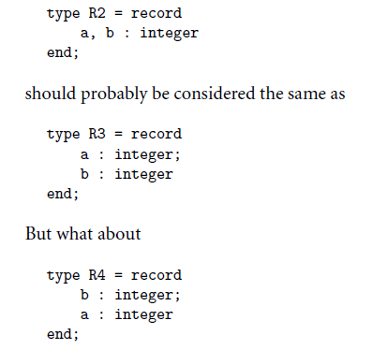
In Pascal

Slide 89
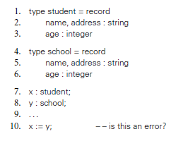
programmers would probably want to be informed if they accidentally
assigned a value of type school into a variable of type student,
but a compiler whose type checking is based on structural equivalence will accept such an assignment.

Slide 90
Name equivalence is based on the lexical occurrence of type definitions: roughly speaking, each definition introduces a new type. based on the assumption that if the programmer goes to the effort of writing two type definitions, then those definitions are probably meant to represent different types
– name equivalence is based on declarations
– Java, C#, standard Pascal,
– Type Conversion and Casts
– NonconvertingType Casts

Slide 91
Type Compatibility
coercion
– when an expression of one type is used in a context where a different type is expected, one normally gets a type error
– var a : integer; b, c : real; ... c := a + b;
– many languages allow such statements, and coerce an expression to be of the proper type
– coercion can be based just on types of operands, or can take into account expected type from surrounding context as well
– Fortran has lots of coercion, all based on operand type
– C has lots of coercion, too, but with simpler rules:
– all floats in expressions become doubles
– short int and char become int in expressions
– if necessary, precision is removed when assigning into LHS

Slide 92
– Overloading and Coercion
Some operators such as + are overloaded: + has several possible types for example:
int +(int,int),
float +(float, float)
but also float* +(float*, int)
int* +(int, int*) depending on the type
the operator + has a different implementation determining which implementation should be used is based on the arguments only
Coercion: allow the application of + to int and float. instead of defining + for all possible combinations of types, the arguments are automatically coerced this coercion may generate code (e.g. conversion from int to float) conversion is usually done towards more general types i.e. 5+0.5 has type float (since float ≥ int)

Slide 93
Type Inference
– ability to automatically deduce, either partially or fully, the type of an expression at compile time
– the system will automatically infer that the header of f ought to have been fun f(x :: Boolean, y :: Number): ...
fun f(x, y):
if x:
y + 1
else:
y - 1
end
End

Slide 94
Subroutine and Control Abstraction

Slide 95
Subroutines are the principal mechanism for control abstraction in most programming languages.
A subroutine performs its operation on behalf of a caller,who waits for the subroutine to finish before continuing execution.
Most subroutines are parameterized: the caller passes arguments that influence the subroutine behavior, or provide it with data on which to operate.
Arguments are also called actual parameters. They are mapped to the subroutine formal parameters at the time a call occurs.
A subroutine that returns a value is usually called a function.
A subroutine that does not return a value is usually called a procedure.
Most languages require subroutines to be declared before they are used, though a few (including Fortran, C, and Lisp) do not. Declarations allow the compiler to verify

Slide 96
Stack Layout,
Calling sequence, parameter passing

Slide 97
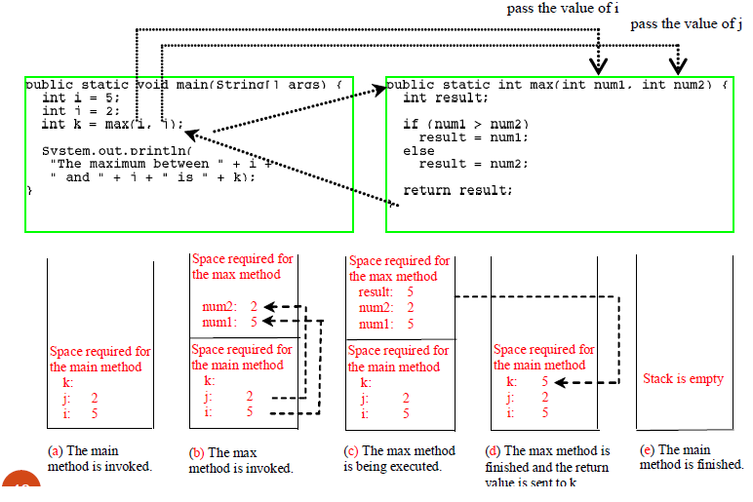

Slide 98
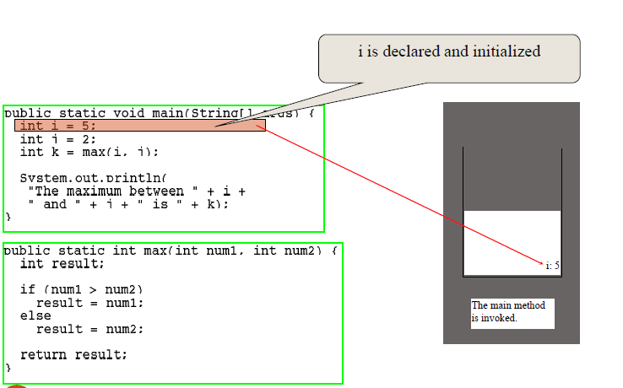

Slide 99
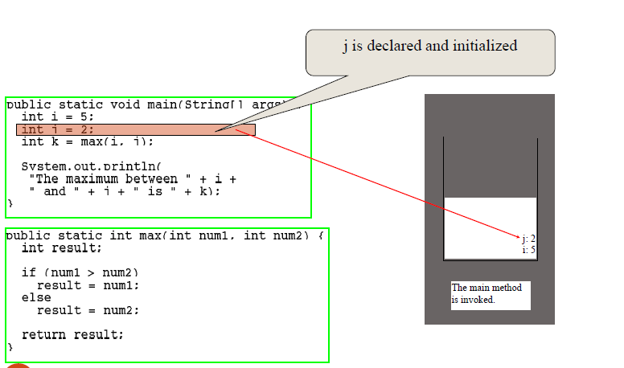

Slide 100
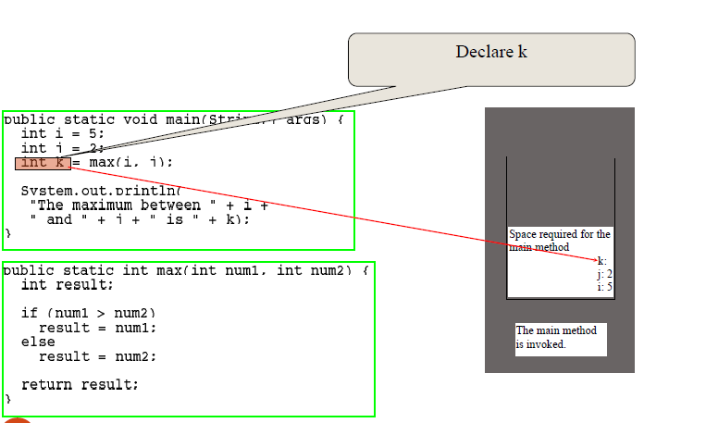

Slide 101
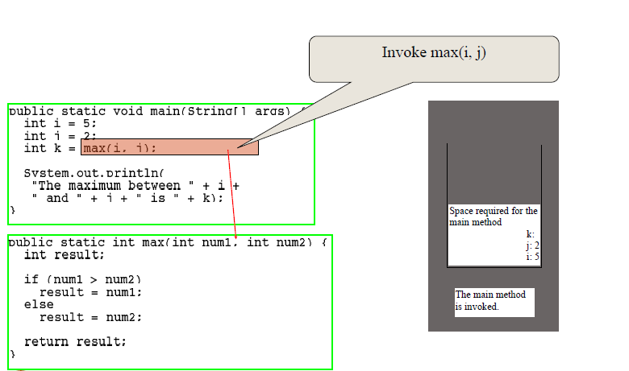

Slide 102
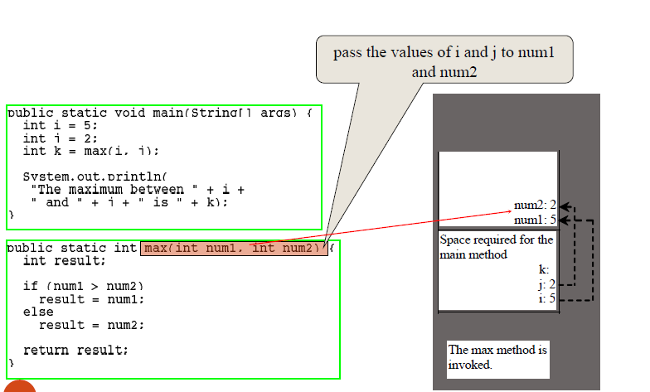

Slide 103
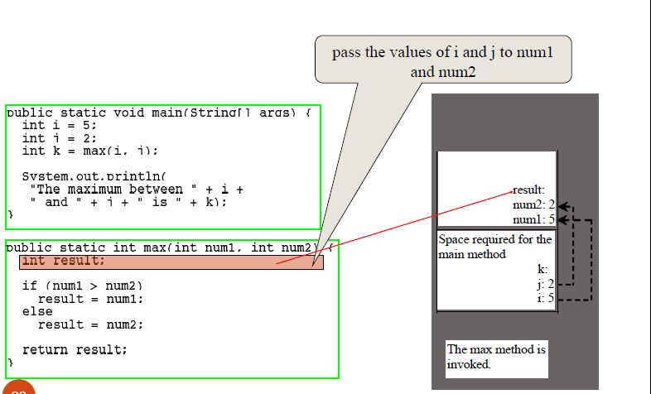

Slide 104
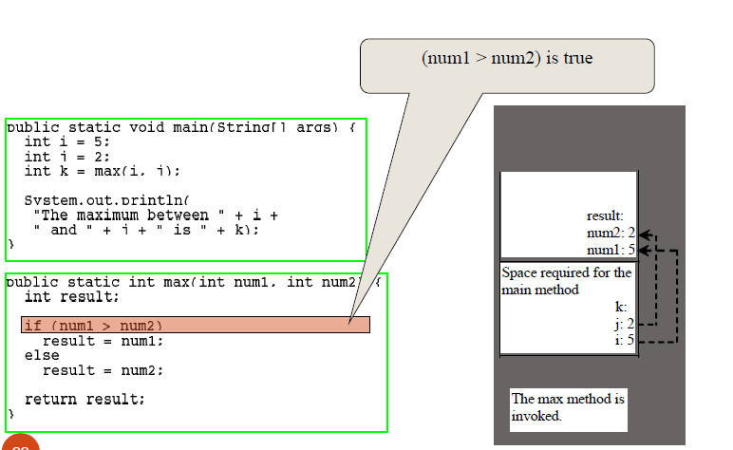

Slide 105
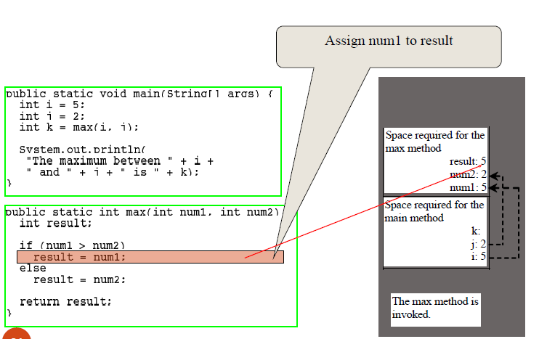

Slide 106
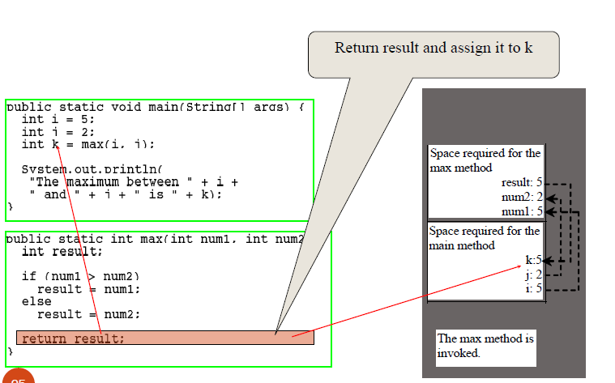

Slide 107
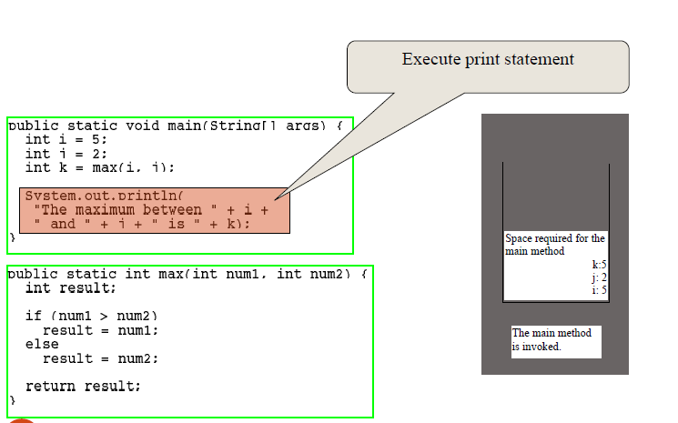

Slide 108
Reminder: maintenance of stack is responsibility of calling sequence and subroutines prologue and epilogue
Optimizations:
space is saved by putting as much in the prolog and epilogue as
possible
time may be saved by
putting stuff in the caller instead or
combining what's known in both places ( interprocedural optimization)
Unfolding subroutines (e.g., Prolog/ Datalog unfolding optimizations)
One cannot return references to objects on the stack
Rookie mistake in C: the lifetime is limited to function scope.

Slide 109
Stack pointers:
The frame pointer (fp ) register points to a known location within the frame of the current subroutine
fp usually points to the parameters (above the return address) for the current call
The stack pointer sp ) register points to the first unused location on the stack (or the last used location on some machines)
sp would point to where arguments would be for next call
Local variables and arguments are assigned fixed OFFSETS from the stack pointer or frame pointer at compile time

Slide 110
Parameter Passing
Most subroutines are parameterized: they take arguments that control certain aspects of their behavior, or specify the data on which they are to operate.
Parameter names that appear in the declaration of a subroutine are knownas formal parameters.
Variables and expressions that are passed to a subroutine in a particular call are known as actual parameters.
Also called arguments

Slide 111

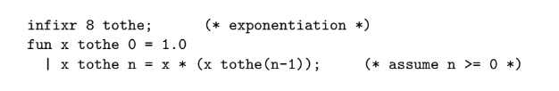
Prefix notation
In scala
Infix notation
ML allows the programmer to specify that certain names represent infix operators, which appear between a pair of arguments:
Fortran 90 also allows the programmer to define new infix operators, but it requires their names to be bracketed with periods (e.g., A .cross. B), and it gives them all the same precedence. Smalltalk uses infix (or “mixfix”) notation (without precedence) for all its operations.

Slide 112
Parameter Modes
Some languages—including C, Fortran, ML, and Lisp—define a single set of rules that apply to all parameters.
Other languages, including Pascal, Modula, and Ada, provide two or more sets of rules, corresponding to different parameter-passing modes.
As in many aspects of language design, the semantic details are heavily influenced by implementation issues.
Different modes:
Call-by-value
Call-by-reference
Call-by-Sharing
Read-Only Parameters

Slide 113
In Pascal, parameters are passed by value by default; they are passed by reference if preceded by the keyword var in their subroutine header’s formal parameter list.
Parameters in C are always passed by value, though the effect for arrays is passed by reference
Neither call by value or reference option really makes sense in a language like Smalltalk, Lisp, ML, or Clu, in which a variable is already a reference, calls this mode call-by-sharing.
Java uses call-by-value for variables of built-in type (all of which are values), and call-by-sharing for variables of user-defined class types (all of which are references).

Slide 114
Why call by reference?
if the called routine is supposed to change the value of an actual parameter (argument), then the programmer must pass the parameter by reference.
to ensure that the called routine cannot modify the argument, the programmer can pass the parameter by value.
the implementation of value parameters requires copying actuals to formals, a potentially time-consuming operation when arguments are
large. Reference parameters can be implemented simply by passing an address. (Of course, accessing a parameter that is passed by reference requires an extra level of indirection. If the parameter is used often enough, the cost of this indirection may outweigh the cost of copying the argument.)

Slide 115


Special-Purpose Parameters
Default (Optional) Parameters
Named Parameters
Variable Numbers of Arguments

Slide 116
Generic Subroutines and Modules
Subroutines provide a natural way to perform an operation for a variety of different object (parameter) values.
In large programs, the need also often arises to perform an operation for a variety of different object types.
An operating system, for example, tends to make heavy use of queues, to hold processes, memory descriptors, file buffers, device control blocks, and a host of other objects.
The characteristics of the queue data structure are independent of the characteristics of the items placed in the queue.
Generic modules or classes are particularly valuable for creating containers

Slide 117
Generic subroutines (methods) are needed in generic modules (classes), and may also be useful in their own right.
A sorting routine, it needs to be able to tell when objects are smaller or larger than each other, but does not need to know anything else about them.
Min routine
Here Implicit parametric polymorphism could be applied but it makes the compiler substantially slower and more complicated. Alternative is explicitly polymorphic
Generic modules or classes are particularly valuable for creating containers data abstractions that hold a collection of objects, but whose operations are generally oblivious to the type of those objects.
Languages that support generic subrountines ar include Ada, C++ (which calls them templates), Clu, Eiffel, Modula-3, Java, and C#.

Slide 118
Exception Handling
An exception can be defined as an unexpected—or at least unusual—condition that arises during program execution, and that cannot easily be handled in the local context.
It may be detected automatically by the language implementation,or the program may raise it explicitly.
Clu, Ada, Modula-3, Python, PHP, Ruby, C++, Java, C#, and ML,

Slide 119
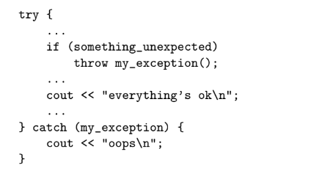
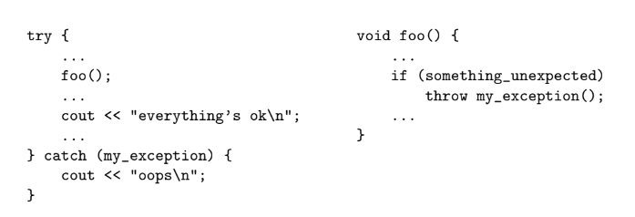
Rule,
if an exception is not handled within the current subroutine, Propagation of an exception out of a called routine then the subroutine returns abruptly and the exception is raised at the point of call.
When an exception occurs in agiven block of code but cannot be handled locally, it is often important to declare a local handler that cleans up any resources allocated in the local block, and then “reraises” the exception, so that it will continue to propagate back to a handler that can (hopefully) recover.
if recovery is not possible, a handler can at least print a helpful error message before the program terminates.

Slide 120
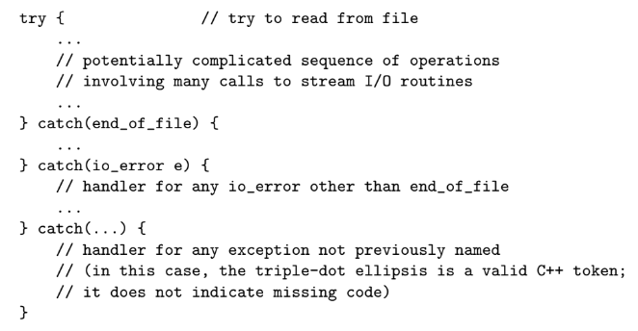
Exception Propagation

Slide 121
Coroutines

Slide 122
Events
An event is something to which a running program (a process) needs to respond, but which occurs outside the program, at an unpredictable time.
Common events are inputs to a
graphical user interface (GUI) system: keystrokes, mouse motions, button clicks.
network operations or other asynchronous I/O activity: the arrival of a message, the completion of a previously requested disk operation.
Sequential Handlers
Need to change the traditionally, event handlers were implemented in sequential programming languages
synchronize access to such shared structures

Slide 123
Thread-Based Handlers
events are often handled by a separate thread of control, rather than by spontaneous subroutine calls.
To protect the integrity of shared data structures, the main program and the handler thread(s) will generally require a full-fledged synchronization mechanism
C#, Java

Slide 124
Books
Understanding Programming Languages, Ben Ari [Chapter 1]
Scott M L, Programming Language Pragmatics, 3rd Edn., Morgan Kaufmann Publishers, 2009 [Chapters: 1(1.1-1.5), 3, 6, 7 (7.1.7.2,7.3) and 8]

